Slide 1
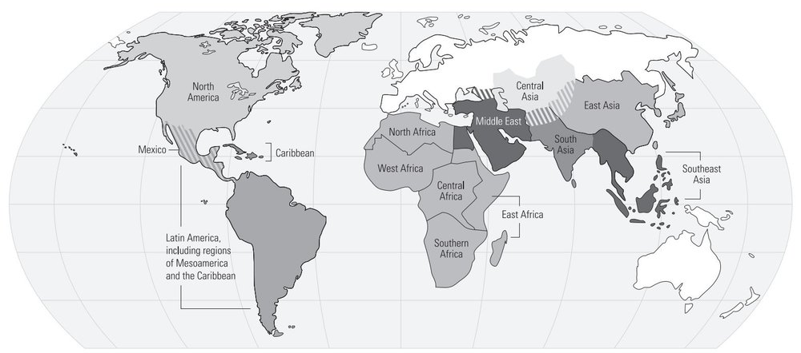
Aim: How did the Early American settlers establish complex societies?
Mesoamerica: The region that includes the southern two-thirds of modern Mexico, Guatemala, Belize, El Salvador, Honduras, Nicaragua, and Costa Rica.
You are here!
Circa 1600 BCE
In the Ancient World (Pre-Classical)

Slide 2
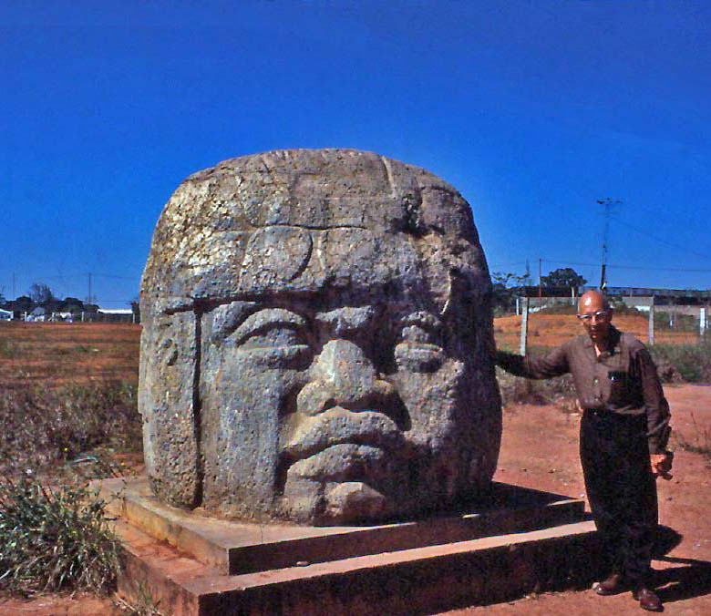
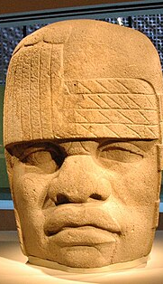
Olmec Colossal Heads

Slide 3
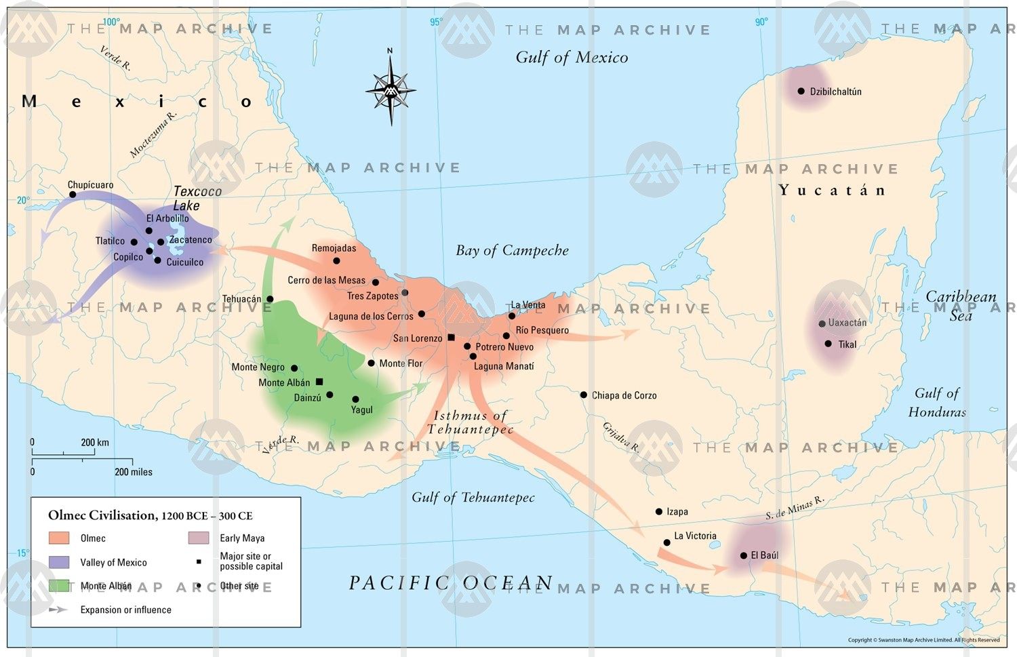
Aim: How did the Early American settlers establish complex societies?
Olmecs (1600-400 BCE): A complex society that arose on the Gulf of Mexico coast from modern-day Veracruz to Tabasco. Known particularly for its massive colossal heads created from basalt.

Slide 4
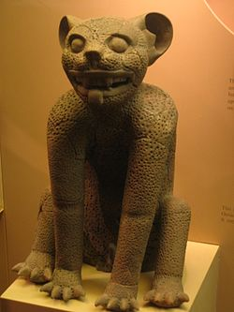
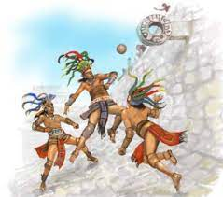
Olmecs- Cultural Aspects
Heavily influenced by their
agricultural lifestyle
Believed in animalistic gods who
controlled different aspects of life.
Ex: Dragon God, Maize God, Jaguar Rain Spirit ,
Jaguar Man, Bird God, Fish God
Built temples to honor their Gods.
Practiced blood letting and human
sacrifice.
Played a sport involving rubber
balls on a stone court. Popular
among many other Mesoamerican
civilizations including the Mayans
and Aztecs
Jaguar Man-
The Were-jaguar was a combination of human and feline characteristics and found at sacrificial altars.
Pok a Tok- Mesoamerican Ballgame
Guiding Question: What two vocab words can we use to characterize Olmec
spiritual beliefs?

Slide 5
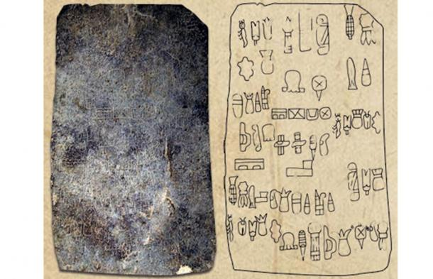
Cascajal Block
The Cascajal Block is a tablet-sized writing slab in Mexico, made of serpentinite, which has been dated to the early first millennium BCE (~1000), in scripted with unknown characters that may represent the earliest writing system in the New World.
Guiding Question: What was the first recorded written language in human history? When was it written?

Slide 6
Why are Ancient American Civilizations not Considered River Valleys?
At height of its power, the Olmec city La Venta, only had a population of about 20,000 people around 900 BCE.
On the other hand :
Mesopotamia, Ur: 65,000 ~2000 BCE
Egypt, Memphis: 30,000 ~2000 BCE
Indus Valley, Harappa: 35,000 ~2600 BCE
China, Zhou Dynasty : 10,000,000 ~1000 BCE

Slide 7
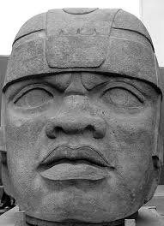
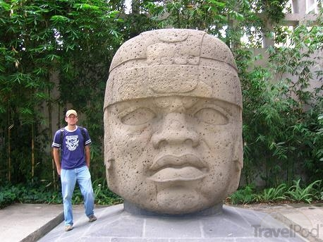
Turn and Talk: Look at the various Olmec works of art on this/the following slides: 1. Why (motivation) might the Olmecs have built these cultural artifacts? 2. What connections can be made between Olmec cultural artifacts and the artifacts of other early complex civilizations?
Aim: How did the Early American settlers establish complex societies?

Slide 8
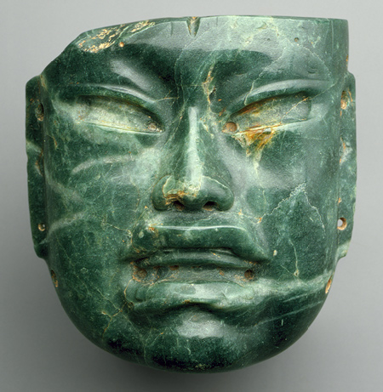
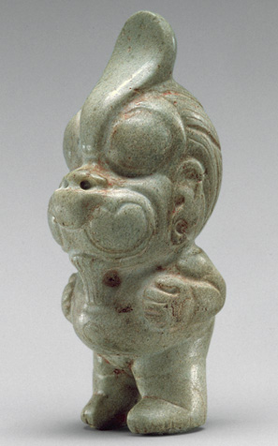
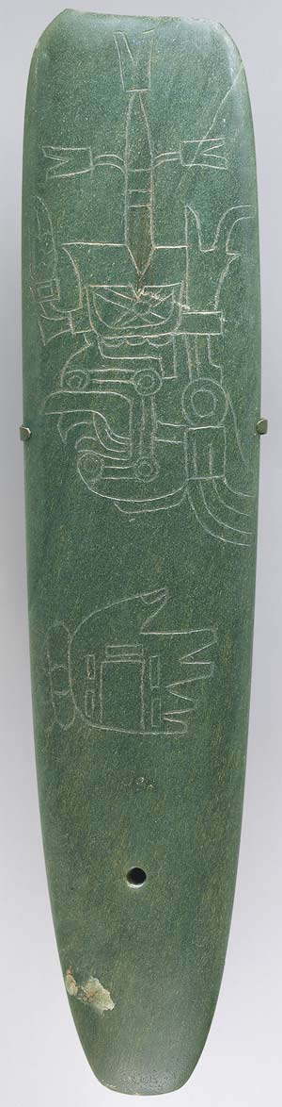
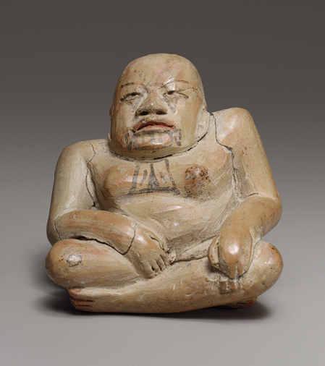

Slide 9
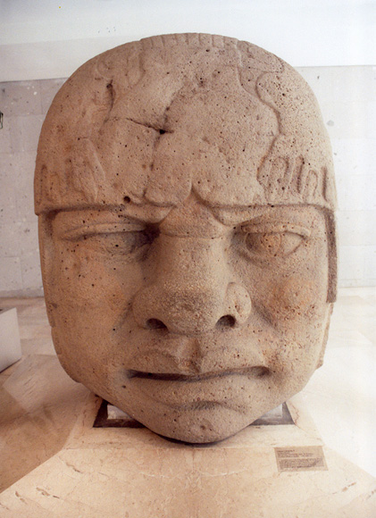
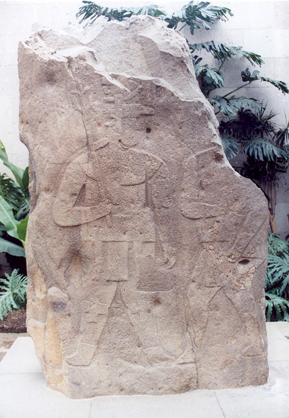
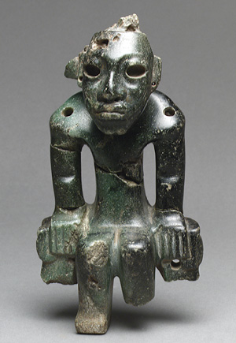
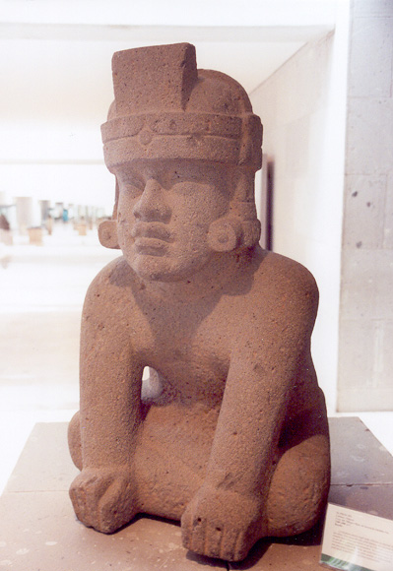
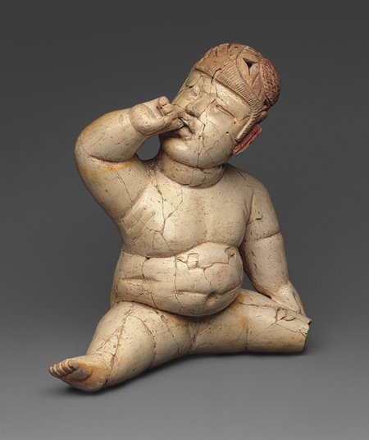

Slide 10
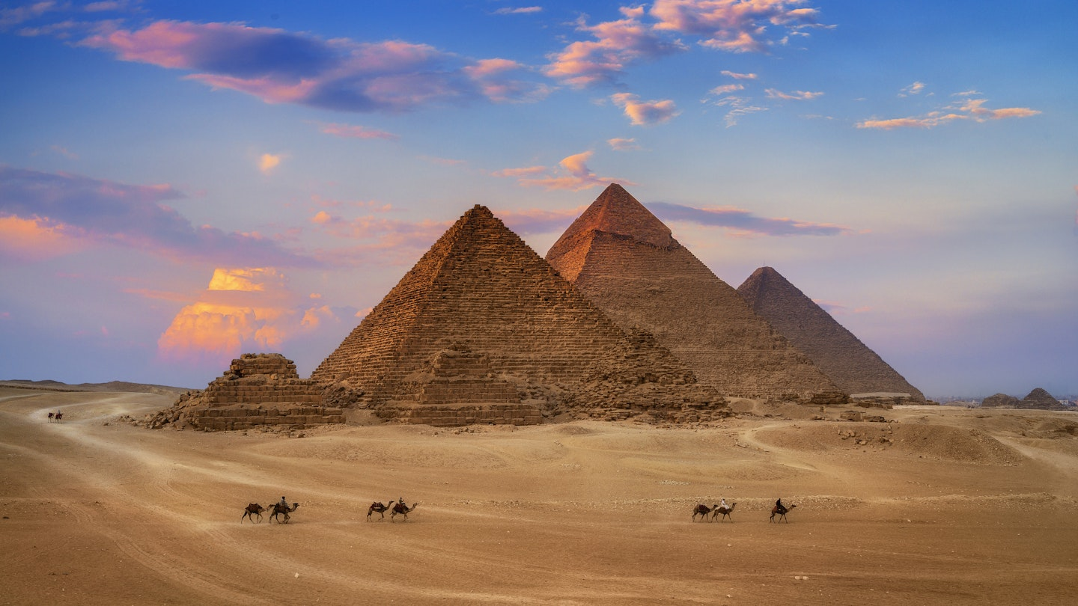
Pyrmaids of Giza, Egypt Constructed ~2600 BCE

Slide 11
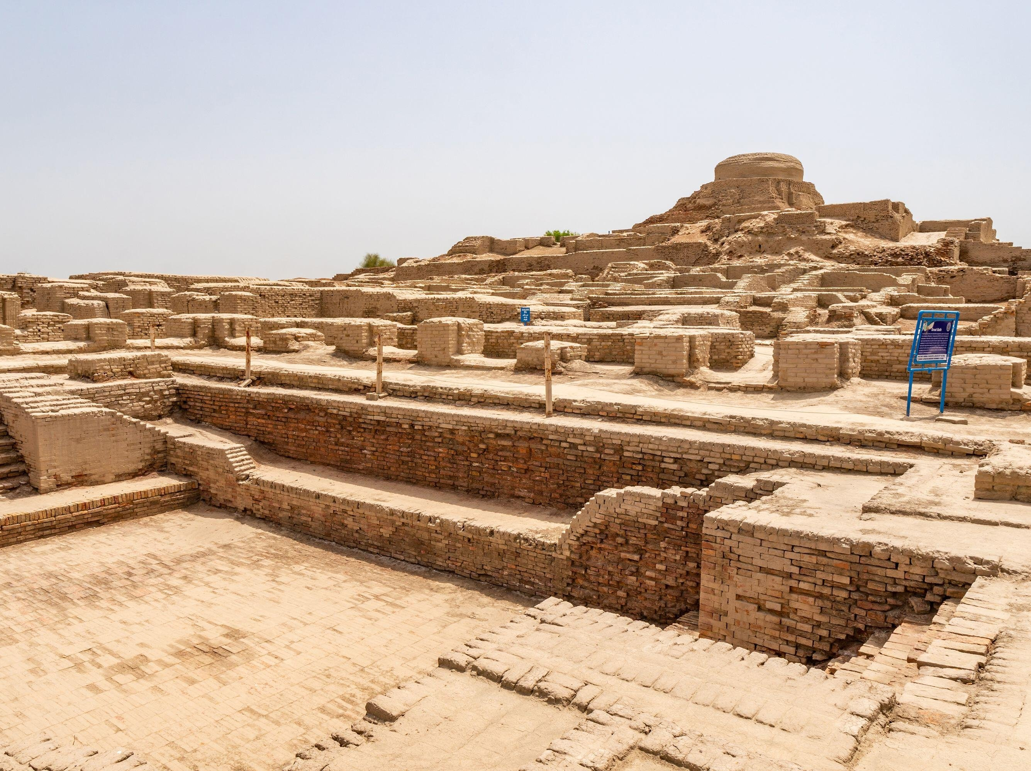
Mohenjo Daro, Indus RV Constructed ~2500 BCE

Slide 12
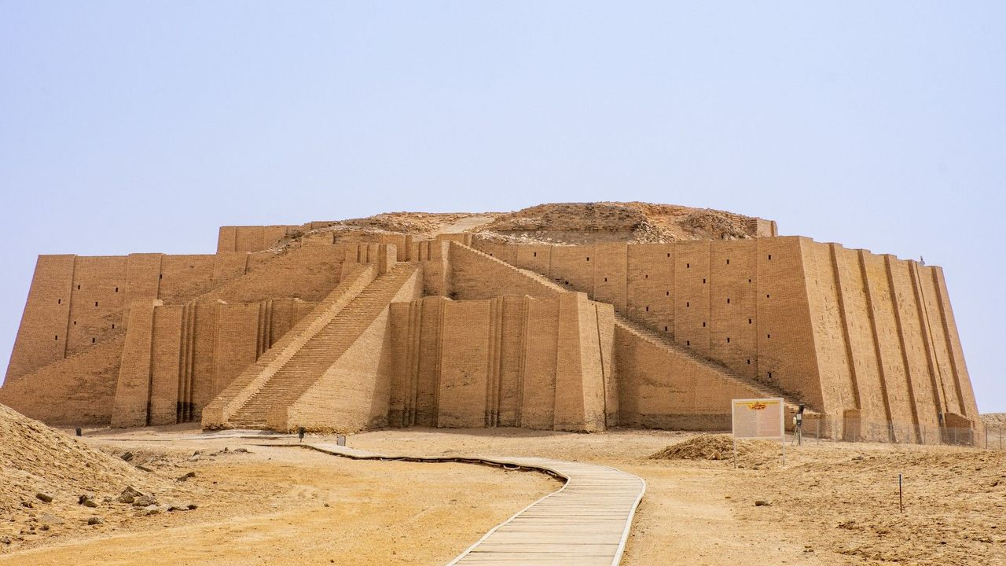
Ziggurat of Ur, Iraq Constructed ~2100 BCE

Slide 13
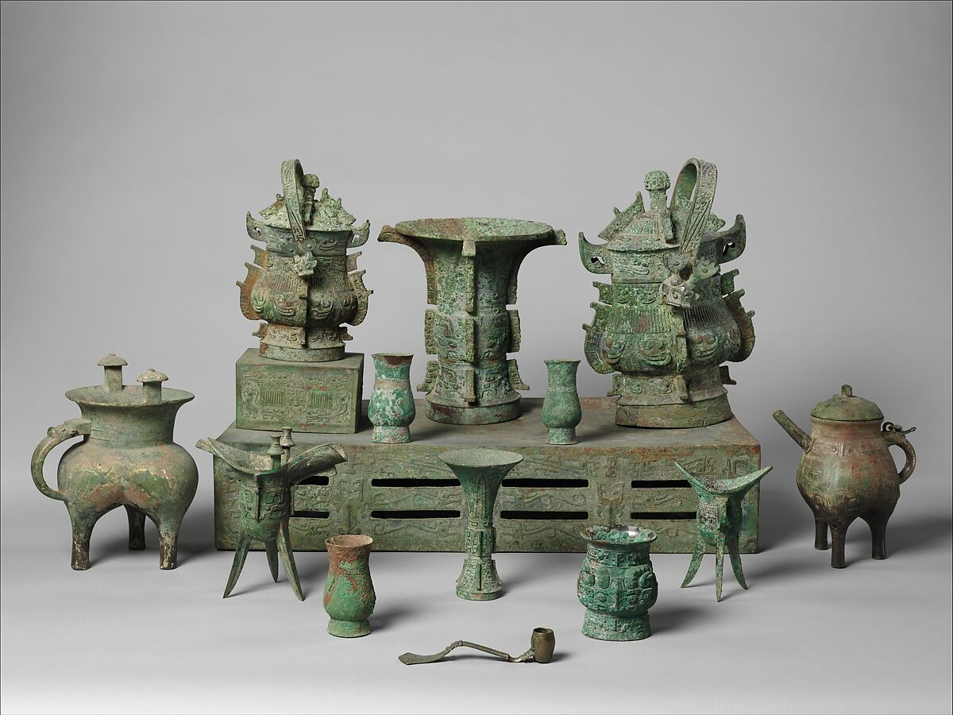
Shang Dynasty Bronze Artifacts Constructed ~1000 BCE

Slide 14
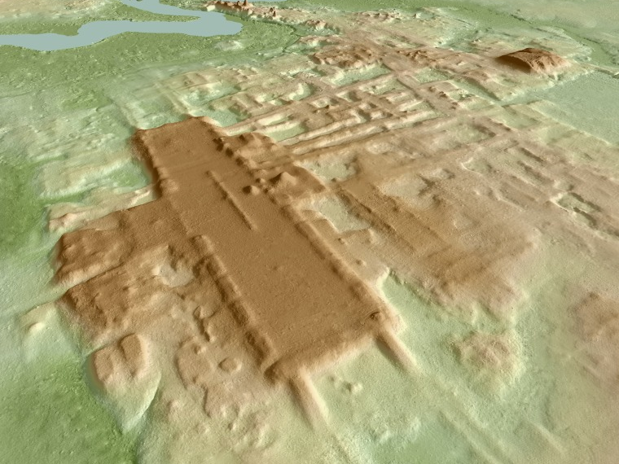
Aguada Fenix, Mexico Constructed ~1000 BCE

Slide 15
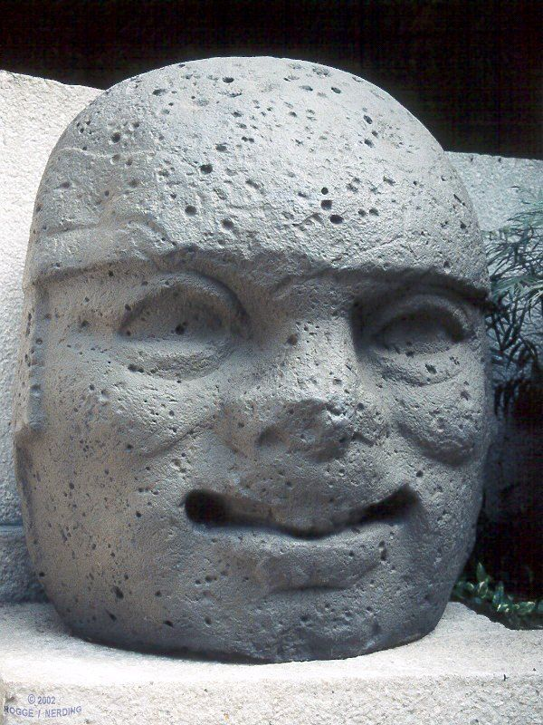
Olmec Heads
Large heads carved out of basalt
Each face is different, varying in facial expressions and features
These differences indicate that these heads have led historians to conclude the heads are based off of Olmec rulers
Often moved around for various purposes, possibly for rituals or declaring territorial control

Slide 16
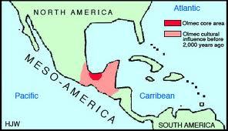
The Olmecs are the Foundations of Mesoamerican Culture
Aim: How did the Early American settlers establish complex societies?
Early settlement patterns-1500 BC-400 BC near Tenochtitlan.
1. Dependence on Hunting and Gathering.
2. Settlement near fertile marsh lands in central America.
3.Development of agriculture- Maize, Gourds, Beans, Squash.
4. Very few domesticated animals available; Wild Game, Dogs and Wild Boar.
5. Interacted through trade and warfare.
6. Use of Obsidian as a tool and rubber. Love of Jade.
7. Animistic religion/ sacred Jaguar.
8. Ritual blood letting and human sacrifice for gods

